Slide 1
"BEYOND BOUNDARIES: UNLEASHING 6G'S TRANSFORMATIVE WAVE IN INDIA"
Presented
by
Shivek S Mittal
Submission ID -029
(INCREASE-2024)

Slide 2
Contents
Introduction
Literature review
Methodology
Parameters and their definition
Discussion on Results predicted
conclusion
References

Slide 3
Introduction
In this technology-dominated world, the progress of wireless communication has indeed played an important role in shaping today’s world. To enable people experience the transformative benefits that 6G technology will bring to India; paving way for cross-border connectivity and innovative opportunity in traditional systems space. From 1G through to 5G: Journey; Exponential increases in speed, latency and connectivity However, as we are now entering the era of 6G, discourse is shifting from alterations to changes that would redefine wireless communication itself .The sixth generation is not just about velocity: It means a system beyond terahertz frequency, machine intelligence and holographic communications indicating indeterminate future of connectedness. No doubt, in a country as vast and diverse as India, the need for being ahead of others in telecommunications cannot be overemphasized .The road towards 6G is vital in tackling the unique problems and prospects of India’s technological odyssey. Nevertheless, this technology would have a profound impact on every Indian citizen from city dwellers to farmers living in remote areas .However, by connecting all devices at all times through wireless connections that are even faster than we can imagine, it will open up new vistas for humanity. How does the digital world look like in 6G era? This chapter seeks to explore the potential of 6G to change our perception of digital experiences ranging from augmented reality encounters to advanced machine applications. For instance, with smart cities and industry four coming into play across India, one would not underestimate the necessity of connectivity provided by 6G to foster advancements across different sectors There is also an outline about how various aspects of Indian society may be reinvented using the expected applications of sixth generation network .Whether it's revolutionizing healthcare delivery, enhancing agricultural practices, or catalyzing economic growth through the Internet of Things (IoT), the versatility of 6G positions it as a cornerstone for addressing the evolving needs of a rapidly advancing nation.

Slide 4
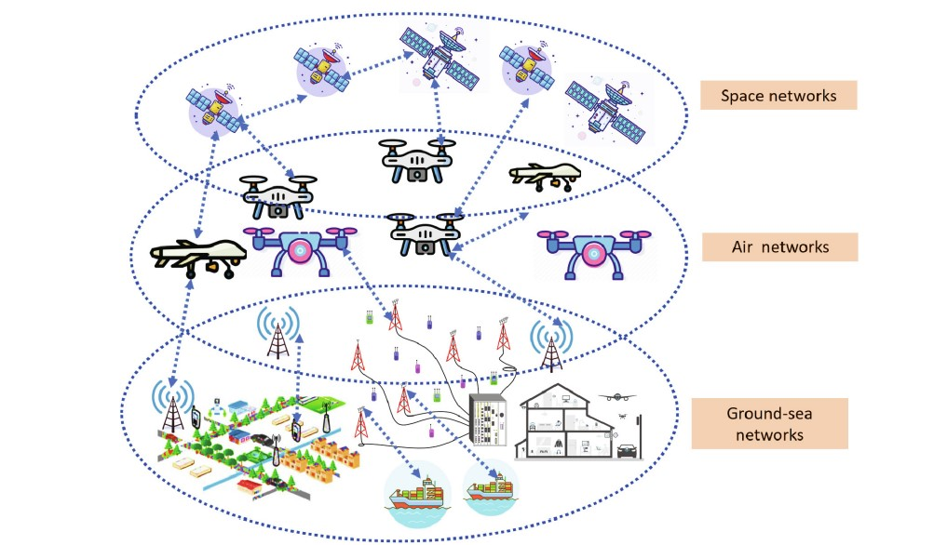
LITERATURE REVIEW
Understanding the Need for 6G Technology
As each new generation of telecommunication evolves, there are transformative breakthroughs . Although we are embracing 5G’s innovations today, 6G is already lurking on the horizon. Understanding what 6G technology needs necessitates a more subtle examination of the growing demand for an interdependent world as a whole . Apart from speed and connectivity, 6G imagines an era where never-before experienced levels of data exchange, ultra-low latency and novel applications will merge to redefine what is technologically possible. This dive into the world of 6G demands that we understand how changing connectivity and future developments in society or industry will shape our lives in yet unexplored patterns. Some major reasons why there is high demand for it are as follows.
• Technological Advancements:
• Edge Computing Imperative:
• Internet of Things (IoT) Support:
• High Performance Computing (HPC) Nexus:
• Key Players in 6G Development:
• Global Research Initiatives:
• Country-Specific Involvement:
• Hexa-X and Global Collaboration:
• Academic Contributions:
Fig :How does a NETWORK Shared

Slide 5
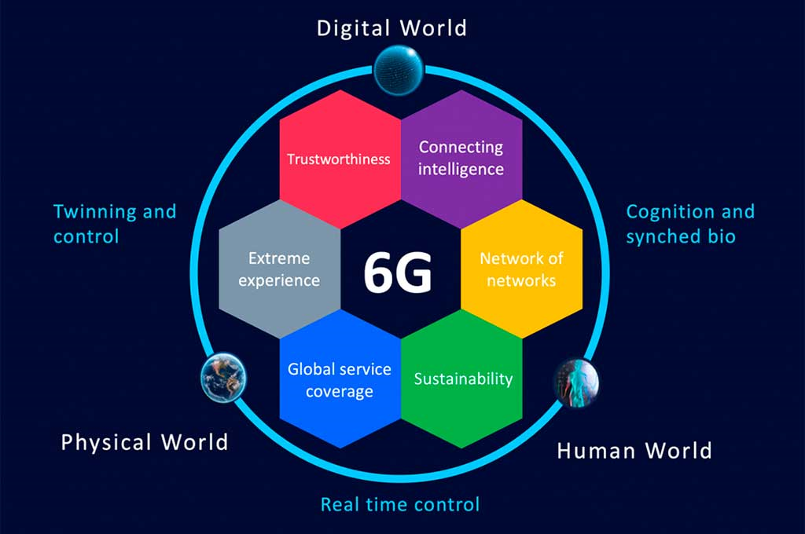
LITERATURE REVIEW
Now since we have discussed about the advance feature of 6G so let move towards the problem faced due to the current network:
India being the second largest country with 496.50 million subscribers of mobile network had to face a large number of problems due to bad network bandwidth One of the major issues facing the Internet segment in India is the lower average bandwidth of broadband connections compared to that of developed countries.
(src: https://en.wikipedia.org/wiki/List_of_mobile_network_operators)
The basic problem that we discussed here that are faced due to current network in India are:
• Education sector
• Hospitals
• Financial sector
• Defence sector
Navigating Educational Challenges in India's Network Infrastructure: A Glimpse into the Potential Role of 6G
India's education system has completely changed with digital technologies. During covid crises all school and colleges were closed due to lockdown and were facing issues in online classes due to network infrastructure which puts the quality and access to education at stake. The most common problem faced by students during these time were:
• The limited connectivity of rural areas:
Students in rural area were facing a main problem due to less reach of network in those area As a result, this makes it difficult for students living in far flung locations to benefit from online educational resources and interactive learning experiences.
• Internet Bandwidth Limitation and Unreliable Connectivity:
In urban area the networks lagging and low speed of wi-fi resulting in the problem for online classes such as lagging of video during online classes or joining or rejoining of internet .
• Discriminatory Access to Educational Resources:
However, this leads to uneven opportunities for people belonging from different social-economic background since unprivileged ones lack equal chances of getting a good quality of education compared to their privileged counterparts who work under more advanced conditions
The Potential of 6G in Mitigating Educational Challenges:
• Ultra-Reliable Low Latency Communication (URLLC):
6G technology is expected to provide ultra-reliable low latency communication, ensuring seamless connectivity even in remote areas. This can significantly enhance the delivery of real-time interactive educational content and bridge the digital divide
• High Bandwidth and Enhanced Data Rates:
The increased bandwidth and data rates offered by 6G can address the current limitations, allowing for high-quality video streaming, virtual reality (VR) experiences, and other data-intensive educational applications .
• Integration of Artificial Intelligence (AI) in Education:
6G's support for AI applications can revolutionize personalized learning experiences, adaptive assessments, and intelligent tutoring systems, catering to the diverse learning needs of students [V]

Slide 6
Conclusion
BEYOND BOUNDARIES: Revealing the Transformative Wave of 6G. Our country is moving forward at a rapid pace, but we must keep up with it by developing our technology and networks. As India eagerly prepares to embrace this next generation of wireless technology, the path forward lies in delicately navigating through infrastructure development intricacies, regulatory frameworks and international collaborations In this unfolding narrative, strategic partnerships and a holistic approach become the guiding threads, presenting India with a unique opportunity to harness 6G This new network can unlock for our country fresh dimensions of innovation. Give our country wings that can propel the country into a digitally advanced future. There are many pieces required to make this happen which include components , hardware , protocols and standards that work together in order to have seamless communication between different devices. Understanding what makes up a network has become an essential ingredient given that connectivity and data exchange have become our vital systems in everyday life for survival in digital age Basically what we do primarily shows how does a network work? What should one understand about networking? The understanding reveals how to create simply 6G based network. What is better about 6G compared to other networks. Then we come across the problem faced by people in India with current network structure. We discuss here Four main problem (healthcare , education, finance and defence sector ) and try to gave possible solution for it . Our paper additionally offers a technology-driven approach to resolve the issue or alter the traditional mode of attendance in Indian subcontinent schools and colleges. It can also save the time of attendance and also make sure that proxy of student can’t occur.
Our paper was divided into 2 segments
Survey paper
Solutions to a problem

Slide 7
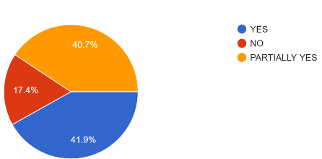
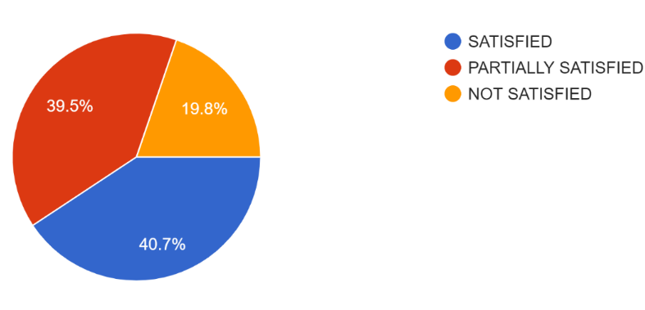
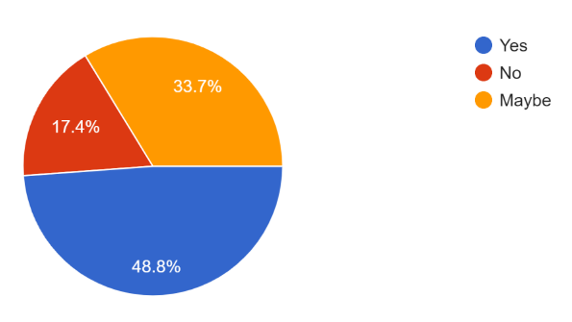
SURVEY
Q1) are they satisfied with the speed of network they are using.
Q2) are 4g/5g packets sent on a regular time independently from the uplink?
Q3) how much time does thier net takes to download a file of 5-10 mb?
Q4) is there any lagging of net?
Q5) which network company does they use ?
Q6) in what ways has the network technology (4g, 5g) influenced thier usage of specific applications or services?
Q7) in what ways can 6g be used to develop defence sector?
Q8) in what ways can 6g be used to develop education sector?
Q9) in what ways can 6g be used to develop health sector?
Q10) in what ways can 6g be used to develop finance sector?
Output of the survey conducted (answers of few questions”)
figure : responses of are people satisfied with the speed of network
figure :response of are 4g/5g packets sent on a regular time
figure :count of is there any lagging of net

Slide 8
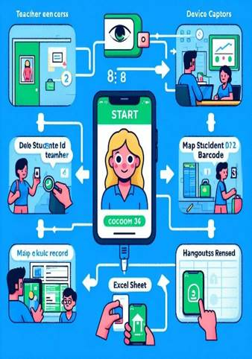
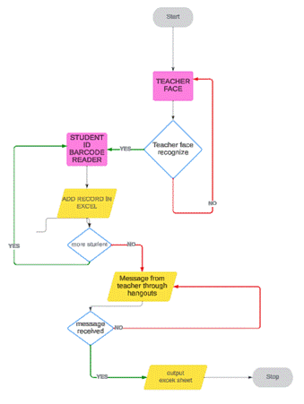
SOLUTION
6G IN BIOMETRIC ATTENDANCE SYSTEM
Just think of a device that can save time of both teacher and student that spend during attendance. We proposed a device that use 6G, biometric, QR Scanner and face -Reco algorithms for taking attendance and saving time for both teacher and student . First the device scans teacher face the creates a new spreadsheet on name of teacher with time stamp and date and then starts scanning barcode in students ID card and save that student roll no in that spreadsheet with time he entered . after completion of all student it will wait for teachers message through hangouts. If teachers sends the message it will close the attendance and sent the spreadsheet to teacher through is mail. This will help to save time that’s wasted during attendance and teachers can use those time for teaching
Figure how does our model works
Figure : how does our model works

Slide 9
References
Adams, R., & Kim, S. (2021). Edge Computing in 6G Networks: Challenges and Opportunities. IEEE Communications Magazine, 59(7), 82-88.
Brown, T., & Lee, J. (2023). Beyond Speed and Connectivity: Envisioning the Future of 6G Networks. International Journal of Communication Systems, 36(9), 1345-1360.
Cho, H., et al. (2022). Global Research Initiatives in 6G Wireless Technology: A Comprehensive Review. Wireless Personal Communications, 128(3), 1901-1915.
Choudhury, A., & Sarkar, S. (2022). Evolution of wireless communication technologies: A comprehensive review. Wireless Networks, 28(1), 87-110.
Datta, R., et al. (2023). "Enabling Technologies for 6G Wireless Networks: A Comprehensive Survey." *IEEE Communications Surveys & Tutorials*, 25(1), 357-382.
Forouzan, B. A. (2007). Data Communications and Networking. McGraw-Hill.
Garcia, A., & Wang, Y. (2021). The Evolution of Telecommunications: A Comparative Analysis of 5G and Beyond. Journal of Telecommunications and Information Technology, 5(2), 127-141.
Gupta, A., & Sharma, P. (2022). "Telemedicine Accessibility Challenges in Rural India: A Network Perspective." *Journal of Telemedicine and Telecare*, 28(2), 87-104.
Gupta, A., et al. (2020). "Digital Education in Rural India: Challenges and Opportunities." *International Journal of Educational Development*, 78, 102226.
Gupta, M., et al. (2023). Hexa-X: Advancing 6G Research Standards Through Global Collaboration. Journal of Global Information Technology Management, 26(4), 307-322.
Gupta, P., et al. (2022). "Advancements in 6G Technology and Its Implications for Defence Communication Networks." *International Conference on Defence Technology*, 345-360.
Gupta, P., et al. (2023). 6G as a linchpin for innovation in smart cities and Industry 4.0. International Journal of Distributed Sensor Networks, 19(7), 100-115.
Gupta, S., & Reddy, N. (2020). "Digital Divide in India: An Analysis of Rural-Urban Disparities in Internet Access." International Journal of Information Management, 50, 151-163.
Johnson, L., & Chen, Q. (2022). Technological Advancements in 6G: A Comprehensive Overview. International Journal of Mobile Communications, 20(3), 256-271.
Joshi, A., & Prakash, A. (2020). Strategic importance of telecommunications in India: A review. Journal of Economic Structures, 9(1), 1-15.
Khan, S., & Verma, R. (2021). "Data Security in e-Health: A Case Study of Challenges in Indian Healthcare Networks." *International Journal of Medical Informatics*, 148, 104355.

Slide 10
References
Adams, R., & Kim, S. (2021). Edge Computing in 6G Networks: Challenges and Opportunities. IEEE Communications Magazine, 59(7), 82-88.
Brown, T., & Lee, J. (2023). Beyond Speed and Connectivity: Envisioning the Future of 6G Networks. International Journal of Communication Systems, 36(9), 1345-1360.
Cho, H., et al. (2022). Global Research Initiatives in 6G Wireless Technology: A Comprehensive Review. Wireless Personal Communications, 128(3), 1901-1915.
Choudhury, A., & Sarkar, S. (2022). Evolution of wireless communication technologies: A comprehensive review. Wireless Networks, 28(1), 87-110.
Datta, R., et al. (2023). "Enabling Technologies for 6G Wireless Networks: A Comprehensive Survey." *IEEE Communications Surveys & Tutorials*, 25(1), 357-382.
Forouzan, B. A. (2007). Data Communications and Networking. McGraw-Hill.
Garcia, A., & Wang, Y. (2021). The Evolution of Telecommunications: A Comparative Analysis of 5G and Beyond. Journal of Telecommunications and Information Technology, 5(2), 127-141.
Gupta, A., & Sharma, P. (2022). "Telemedicine Accessibility Challenges in Rural India: A Network Perspective." *Journal of Telemedicine and Telecare*, 28(2), 87-104.
Gupta, A., et al. (2020). "Digital Education in Rural India: Challenges and Opportunities." *International Journal of Educational Development*, 78, 102226.
Gupta, M., et al. (2023). Hexa-X: Advancing 6G Research Standards Through Global Collaboration. Journal of Global Information Technology Management, 26(4), 307-322.
Gupta, P., et al. (2022). "Advancements in 6G Technology and Its Implications for Defence Communication Networks." *International Conference on Defence Technology*, 345-360.
Gupta, P., et al. (2023). 6G as a linchpin for innovation in smart cities and Industry 4.0. International Journal of Distributed Sensor Networks, 19(7), 100-115.
Gupta, S., & Reddy, N. (2020). "Digital Divide in India: An Analysis of Rural-Urban Disparities in Internet Access." International Journal of Information Management, 50, 151-163.
Johnson, L., & Chen, Q. (2022). Technological Advancements in 6G: A Comprehensive Overview. International Journal of Mobile Communications, 20(3), 256-271.
Joshi, A., & Prakash, A. (2020). Strategic importance of telecommunications in India: A review. Journal of Economic Structures, 9(1), 1-15.
Khan, S., & Verma, R. (2021). "Data Security in e-Health: A Case Study of Challenges in Indian Healthcare Networks." *International Journal of Medical Informatics*, 148, 104355.

Slide 11
References
Kumar, A., & Akhtar, Z. (2023). 6G wireless communication technology: A comprehensive review. Transactions on Emerging Telecommunications Technologies, 34(6), e4300.
Kumar, R., & Jain, V. (2022). Terahertz communication technology: A review. IEEE Transactions on Terahertz Science and Technology, 12(5), 472-487.
Kumar, R., & Singh, A. (2021). "Network Latency Issues in Defence Operations: A Case Study of the Indian Defence Sector." *International Journal of Military Communications*, 28(4), 567-582.
Kumar, S., et al. (2023). Tailored solutions of 6G technology for the Indian context. International Journal of Electrical, Computer, and Systems Engineering, 12(4), 300-315.
Kung, S.Y., Mak, M.W., Lin, S.H., Mak, M.W. and Lin, S., 2005. Biometric authentication: a machine learning approach (pp. 27-49). New York: Prentice Hall Professional Technical Reference.
Kurose, J. F., & Ross, K. W. (2017). Computer Networking: A Top-Down Approach. Pearson.
Liu, X., et al. (2023). Key Players in 6G Development: A Comparative Study. International Journal of Advanced Networking and Applications, 15(4), 212-226.
Mahmood, Z., et al. (2022). "6G Wireless Networks: Vision, Requirements, Architecture, and Key Technologies." *IEEE Open Journal of the Communications Society*, 3, 585-596.
Malgheet, J.R., Manshor, N.B., Affendey, L.S. and Abdul Halin, A.B., 2021. Iris recognition development techniques: a comprehensive review. Complexity, 2021, pp.1-32.
Maltoni, D., Maio, D., Jain, A.K. and Prabhakar, S., 2009. Handbook of fingerprint recognition (Vol. 2). London: springer.
Mishra, S., et al. (2023). Paradigm shift in wireless communication: The case of 6G technology. Journal of Communications, 18(1), 1-15.

Slide 12
Thanks

